Slide 1


SMART INDIA HACKATHON 2025
TITLE PAGE
Problem Statement ID – SIH25132
Problem Statement Title – Student Innovation
Theme – Miscellaneous
PS Category – Software
Team ID - PI/SIH082
Problem Statement – Outdated school systems, lacking modern technology and safety protocols, hinder student success and frustrate everyone involved.
Team Name – Coding Crusaders

Slide 2
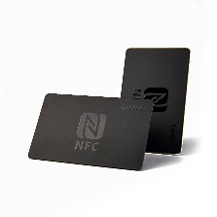
Coding
Neo-Card
Crusaders
Idea Details NEO card- Your School's All-in-One Solution
The Neo-Card NFC-based Platform is a game-changer in terms of streamlining school-related infrastructure as well improving student experience.
Under the NFC card system what we will provides, they are –
Addressing the Problem with NFC Card
Manual processes in school operations are error-prone and time-consuming.
Security risks
Real-time data is often lacking in schools
Challenges in Managing multiple systems
Payment System – Allowing students to pay for school fees, canteen purchases, and stationery items through the smart NFC card.
Attendance Tracking – Automatically marking students attendance when they tap their card at the classroom, where our NFC technology is installed.
GPS Tracking and Geofencing – Monitoring the location and Manages access to certain areas based on the student's location, ICE.
Library Data – For Book issuing and returning, fines, etc.
Data Management – Centralized storage of student data, transaction history, and attendance records.
Such many more works includes under NFC card system – School bus attendance ,examination attendance and for sports book issuing.
Innovation and Uniqueness of NFC Card
NFC Card automates tasks in school which reducing errors and administrative effort.
Real-Time Tracking and Geofencing for students safety.
Comprehensive Data Management for complete view of student activities.
Customizable Alerts and Notifications
User-friendly mobile app and web portal for easy access.
2

Slide 3
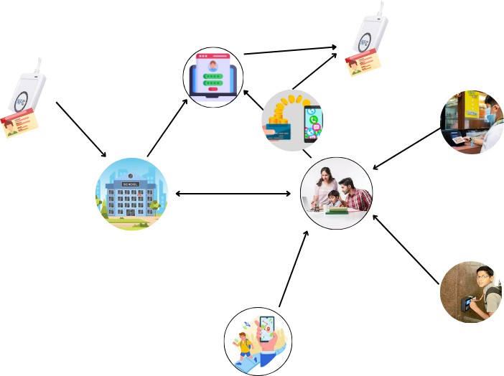








TECHNICAL APPROACH
Coding
Crusaders
Technical and Hardware Stack
Hardware
NFC cards and NFC Readers
GPS Module
Application Development
Django and Flask– Scalable Backend Development.
Android development for App
Databases Management
MySQL , SQLite, MongoDB
Encryption and Security
SSL/TLS , AES-256 , IAM
Live Demo Link
6.
Process Flow Chart
1.
5.
4.
7.
Login Credentials
Adding amount
Canteen , Stationary payment
Card and reader
with software
integrated
2.
3.
Linked
School
Parents
8.
Attendance By taping
9.
GPS tracking(in case of emergency)
3

Slide 4
FEASIBILITY AND VIABILITY
Coding
Crusaders
Analysis
1. Target Market
Schools (K-12) as the primary audience.
Focus on urban and suburban areas initially.
Problems
Direct- School management systems with integrated ID
cards.
Indirect- Traditional paper-based systems and generic digital payment solutions.
Revenue Potential
Subscription fees from schools.
Hardware sales and premium services.
Link to Business Model Document
Estimated Profits and Losses
Initial losses expected due to high startup costs.
Break-even likely in 1-2 years, with potential for strong profit margins there after.
 | Potential Challenges and Risks |  |  | Strategies for overcoming these Challenges
1. • • | Technical Challenges Integration Issues System Reliability |  | 1. • • | Technical Strategies Thorough Testing Modular Design
2. • • | Economic Challenges Initial Costs Budget Constraints |  | 2. • • | Economic Strategies Phased Implementation Funding and Grants
3. • • | Operational Challenges User Training Change Management |  | 3. • • | Operational Strategies Training Programs Change Management Plan
4. • • | Security Risks Data Breaches Fraudulent Activities |  | 4. • • | Security Strategies Enhanced Security Measures Fraud Detection Systems
4

Slide 5





IMPACT AND BENEFITS
Coding
Crusaders
Potential Impact on Target Audience
Benefits of Neo-Card
Social Benefits
Impact on Schools
Enhanced Student Safety
Reduced Bullying
Fostering Accountability: Instills a culture of punctuality and prepares responsible citizens.
Operational Efficiency- Simplifies administrative tasks.
Data-Driven Decisions
Economic Benefits
Cost Savings
Increased Revenue
Financial Inclusion
Impact on Students
Convenience as use for multiple purposes
Safety and Security of student
Building a 'Future-Ready' & Safe Campus Brand
Environmental Benefits
Paperless Operations
Reduced Carbon Footprint
Impact on Parents
Peace of Mind Real-time notifications and tracking of student
Financial Control Easy management of
school-related expenses
Active Academic Partnership: Live access to attendance records to stay involved and proactive.
Educational Benefits
New Skill learning
Improved Attendance
Resource Management

Slide 6

RESEARCH AND REFERENCES
Coding
Crusaders
Serial No. | Author Names | Abstract | Links | Year
1. | Janea Dixon & Abdel- Shakour Abuzneeid | Student attendance shapes many aspects of a university; however, it’s still widely recorded by hand. While it is common for a professor to pass around a sign-in sheet to enter in attendance to a web-based application…. | https://doi.org/10.1109/CSCI518 00.2020.00201 | 2022
2. | I.S.Akila & Praveen Pratheek | It is developed to ease the work of students by implementing a smart card system. Each student is given a card with a unique identity chip, which can be used for identification, security, and transactions… | https://ieeexplore.ieee.org/abstra ct/document/10434674/authors#a uthors | 2023
Survey form link
https://forms.gle/YboLX3wm86bvnQdKA
Survey Responses link https://docs.google.com/spreadsheets/d/1UL_L5sM0iLvDy RbdKawE_mpU-uubHIDK-Sw6IdRcPKk/edit?usp=sharing
Neo-Card research report
Demo Video
Survey Report
Project Report
Survey form
Click the link to
access the files
Drive Link
All the Documents are available here for the references

